Slide 1

A Design Thinking Approach for Creating Accessible Learning Materials
Access-Ability Innovators:
Lama Rita El Shammas, Jiaying Li,
Tam Truong, Siddharth Srinivasan

Slide 2
Topic Importance
Empower students with disabilities
Offer equitable educational opportunities by building an inclusive
learning environment
Help designers better understand the needs of the students and their accessibility challenges
Promoting innovation that is used world-wide
Increase in efficiency of the designers work
Room to aid more students

Slide 3
Interview Findings
Designers face many barriers throughout the process
Images in PowerPoint slides and PDFs are not picked up by the screen reader
Math has to written in a specific format for to be read
Design should be student specific
Visual learners would use tactile graphics
Others prefer using Braille
Some only need magnification
Importance of Collaboration and Feedback
Workshops are scheduled for students
Professors collaboration is important
Iterative feedback loop to reach best outcome
Abide by Web Content Accessibility Guidelines

Slide 4
Aspects of the Conceptual Model
Assistive technology
JAWS, NVDA, Narrator, ChromeVox, Voiceover, etc
Personalized to each student
Specific to what system they use
Error Handling
Handle error in runtime, unsupported file (Math equations, Picture, Multimedia)
Different courses has different professors that use different materials
Distributive cognition
Many people collab together to design a system
Intuitive design, coherent to current students’ systems
Effective brainstorming, team meeting increase workflow
Notes:
Our conceptual model reveals 3 important aspects of the designers when creative accessible learning materials: First: Assistive Technology, such as visual tools to aid students with reading are different among the students, for examples, these tools are JAWS, NVDA, narrator, chromeVox, voiceover, etc. Since the students do not use just one single system, it is important for the designers to create a personalized solution, tailored to each specific system that the students are using. This is an important aspect of the conceptual model of the design process because it is a physical limitation that the designers are constrained to when designing, and it is crucial for the designers to established these limitations early on to mitigate designing faulty solutions.
Secondly, When designing something that is dynamic, the designers needs to account for the system in case of runtime errors occur. For example, let’s say that the students click on a pdf file, they might run into such as unsupported file for math, picture, and other media. Because the designers do not know when the students would run into the problem, it is hard to pre-design a consistent system. Students’ courses are updated every semester, it is computationally expensive to redesign the system again and again after every semester. Thus, error handling is important to our conceptual model as it allows the designers to design a sophisticate system that accounts for dynamic events
Third, Designing is not a one person job, hence it is a collective effort of distributive cognition process allowing multiple people to collab together; therefore, designers needs to understand what their peers know and communicate to reach a consensus goal. On top of that, the designers also need to understand the user’s mental model to create an intuitive design that is coherent with the pre-existing system as mentioned above that the users are familiar with. This is crucial aspects of the conceptual model because as the number of designer increases, the need for effective brainstorming sessions, team meetings are needed for productive workflow

Slide 5
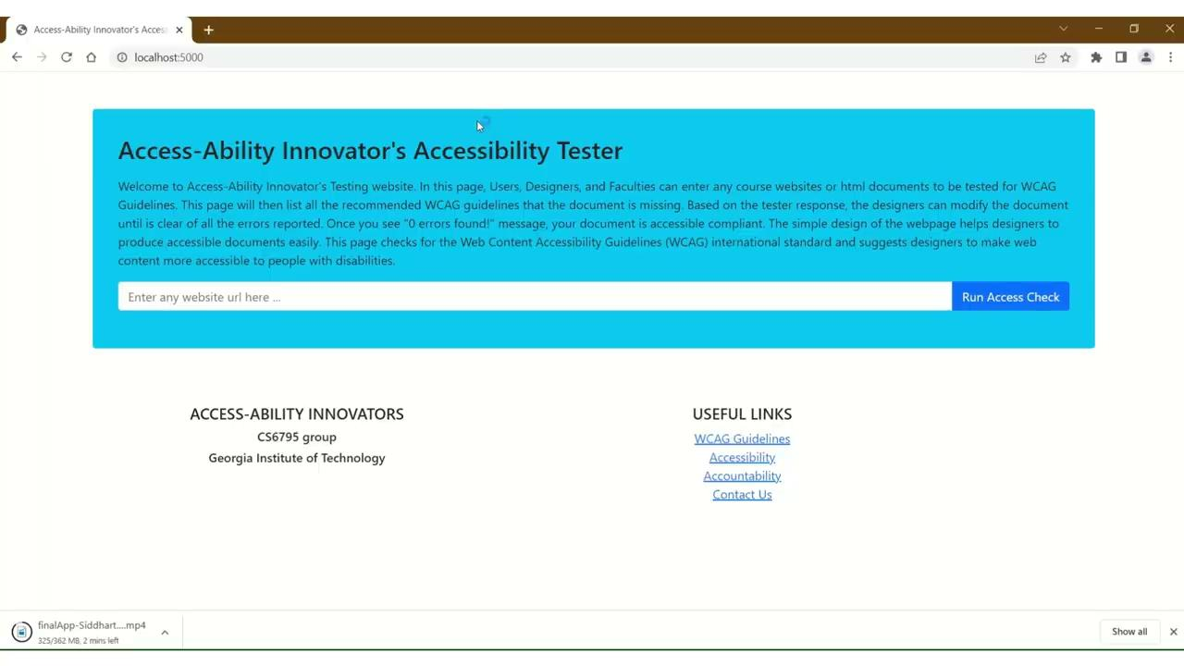
Application Demo

Slide 6
Cognitive Modeling Takeaways
Multisensory Integration
Predefined Templates
Parallel Processing
Notes:
1. Multisensory Integration
Multisensory Integration refers to the way in which our brains combine information from different senses to build a holistic understanding. For visually impaired students, this primarily involves integrating auditory and tactile input.
Designers should design the app or website to provide congruent audio and tactile signals. For instance, as a student navigates through different sections of a course using swipe gestures or keyboard commands, auditory cues can provide additional information about the content, while tactile feedback can confirm successful navigation. Together, these auditory and tactile cues help create a richer, more intuitive user experience.
2. Predefined Templates
In the context of designing an app or website for visually impaired students, employing Predefined Templates can significantly streamline the design process and improve the final product. Templates allow designers to build on proven, effective structures rather than reinventing the wheel with each new feature or section.
By using predefined templates, designers ensure that the interface remains consistent throughout the application or website, making it easier for users to understand and navigate. This consistency is vital for visually impaired users who rely on predictability to interact with digital platforms.
Moreover, templates also ensure that designers adhere to recognized accessibility standards, which are built into the template design. This reduces the risk of accessibility oversights and allows designers to focus on enhancing functionality and user experience.
3. Parallel Processing
Finally, As for Parallel Processing, this principle can guide designers in creating interfaces that cater to the multi-sensory learning strengths of visually impaired students.
From a design perspective, parallel processing implies that designers should consider the synchrony and correlation of different information channels. In this, tasks are divided into smaller chunks of subtasks that can run in parallel on multiple nodes. Without parallel processing, tasks would need to be executed sequentially, significantly increasing the time required to complete computations. It would limit scalability and hinder the ability to efficiently process large amounts of data. By utilizing parallel processing, computations are performed concurrently, leading to faster processing times and increased throughput.

Slide 7
Thank You!

